Slide 1

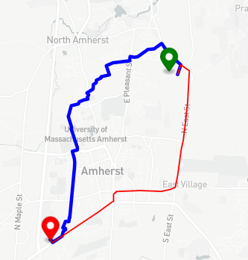
CS 520: Final Presentation
EleNa: Elevation-based Navigation
Minimum Elevation
Group: RedCoders
Members:
Vijaya Gajanan Buddhavarapu
Supriya Shreekant Jahagirdar
Mrinal Tak
Sirisha Annamraju
Devyani Varma
Notes:
SPEAKER ORDER:
Functional and Non-functional requirements - Sirisha
Algorithm Analysis and Design Decisions - Mrinal
Testing and Verification and Validation - Devyani
Learnings and Lessons - Supriya

Slide 2

Demo
Notes:
Speaker Notes:
This is a demonstration of our application. As we can see here, the user has the option to either manually enter the address or select two points on the map. When the user selects a point on the map, a marker is placed on the map and the corresponding coordinates of the point are displayed. After the user enters path limit percentage, the user can submit the form to calculate the route. The blue path is the elevation path and the red path is the shortest path. The route statistics corresponding to each path is displayed in the route statistics box below. The user can press the reset button to calculate another path.
NEXT: Sirisha

Slide 3
Functional and Non-Functional requirements
Functional Requirements:
Given a start and an end location, determine a route that maximizes or minimizes elevation gain, while limiting the total distance between the two locations to x% of the shortest path.
Algorithms to be considered - Shortest Path, Dijkstra, A*
Show route information - distance, elevation gain
Non Functional-Requirements:
Geographic area - Amherst, Massachusetts
Usability -
User input - Mark Points on Map or input address using text box
Output - Display both shortest route and elevation considered route
Reset - reset to original settings
Extensibility -
Strategy design pattern makes it easy to consider more algorithms
We can extend the area to different locations by changing radius.
Notes:
The functional Requirements of the system are
Given a start and an end location, display a route that maximizes or minimizes elevation gain depending on user preference, while limiting the total distance between the two locations to x% of the shortest path.
We have considered 3 algorithms - Shortest Path, daik·struh, A*
Route Information to be displayed to the user are distance, elevation gain
Non Functional-Requirements of the system are
We have limited the geographic area to Amherst, Massachusetts
Usability - User would input the origin and destination by either selecting points on a map or giving a plain address in the search box on UI.
Extensibility -
Strategy design pattern makes it easy to consider more algorithms
We can extend the area to different locations by changing radius.

Slide 4
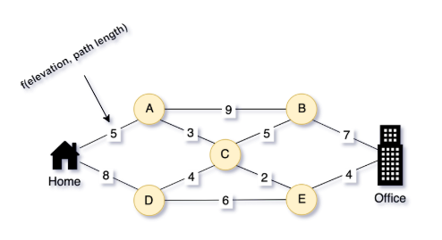
Algorithm Analysis
We chose to implement two algorithms: Dijkstra and A star. Dijkstra is a special case of A star algorithm, where we set the heuristic value to 0.
A star finds the shorter path faster than Dijkstra as we use the heuristic of the distance till the destination node to reduce the time complexity. But Dijkstra is guaranteed to find the shortest path.
We used Binary search algorithm to find the best scaling factor which is used to construct the weighted edges of the graph,
edge_weight = scaling_factor*edge_length + elevation_gain
Notes:
We chose to implement two algorithms: Dijkstra and A star. Dijkstra is a special case of A star algorithm, where we set the heuristic value to 0.
A star finds the shorter path faster than Dijkstra as we use the heuristic of the distance till the destination node to reduce the time complexity. But Dijkstra is guaranteed to find the shortest path.
We used Binary search algorithm to find the scaling factor which is used to construct the weighted edges of the graph.

Slide 5
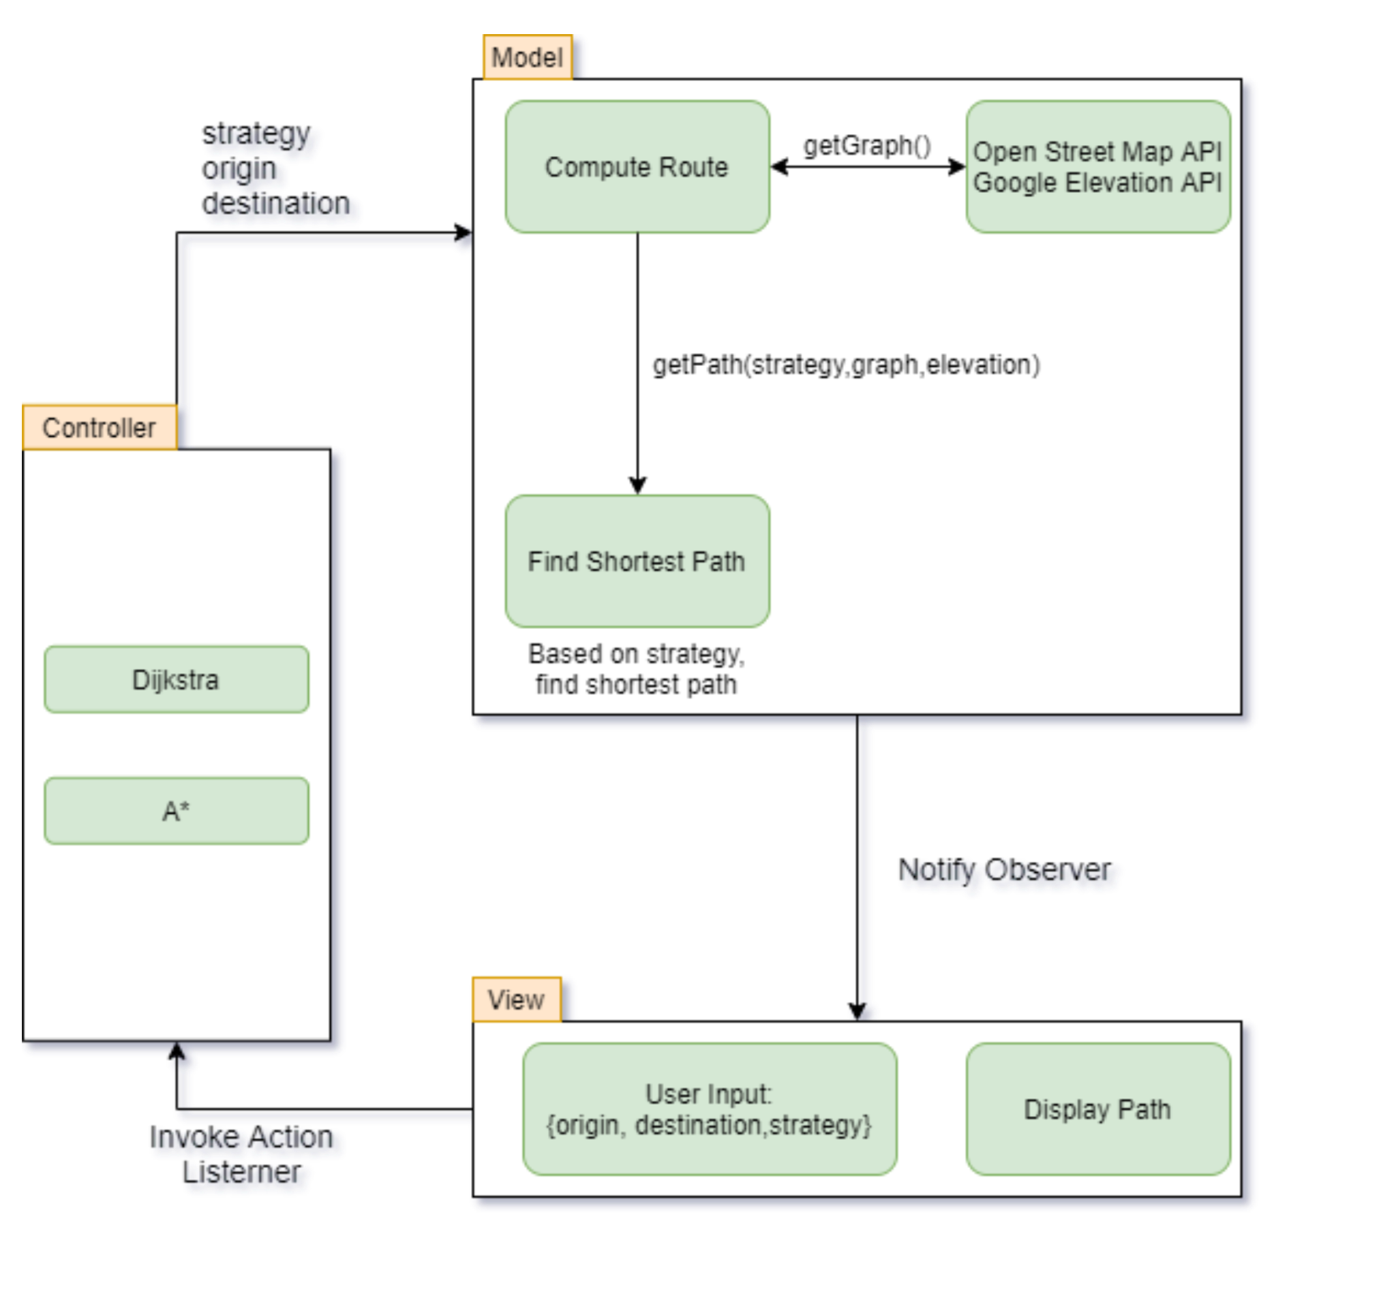
Design Decisions
Design Patterns used
Model View Controller
Strategy design pattern
Observer design pattern
Notes:
We took the decision of using
MVC pattern to navigate between UI, algorithmic computation and different strategies
Observer design pattern is used, where we register different views and all the views are notified when model changes states.
Our first git commit was to have MVC pattern package structure, which made it easy to divide the task among the members, as we all worked on our different packages.

Slide 6

Testing
White Box Test Suites:
Alpha testing
API testing
Black Box Testing
Unittest testing of MVC and all modules in python.
Integration Testing
End to end testing, by asserting on the output routes
System testing
To have an intuitive final product.
Regression testing
To test in an ongoing project, utilized previous test-sets to see if any faults had emerged.
Notes:
To test the functional and non-functional requirements, we adopted a comprehensive strategy with focus on all components of the project.
We employed White Box method while implementing API tests and alpha testing as an acceptance criterion for the project.
The Black Box testing involved testing different GUI components for instance, selecting different points on a map. We did unit test in python to rule out errors in our design pattern of MVC. Post the standalone unit tests, we performed integration testing to ensure the GUI and functionality worked in sync. We also performed system test to ensure we had an intuitive final product. To avoid unintended changes in the program during ongoing development, we made use of regression testing and ran it on previous set of test cases to see if any faults had emerged.

Slide 7
Verification and
Validation
Manual test data creation - We manually created a {input,output} test data suite, by verifying the origin and destination addresses from google maps. We determined all the possible routes by considering elevation for known origin and destination and then compared it against the routes given by Dijkstra.
Coding test suite - We then added a unit test suit and one integration test suite, and tested all the modules.
Extensibility - A* was then added and as the system had sufficient testing in place, we were able to quickly verify, modify and implement A* pretty fast.
Notes:
Verifying and validating involved testing whether the software met the technical requirements as guided by it’s design and development as well as, the user requirements effectively and efficiently while handling all the exceptional and boundary cases. For instance, to verify the origin and destination addresses, we manually created a test data suite to compare with outputs from google maps.
Testing navigation applications requires an end-user viewpoint and a lot of the defects are functional. Such as, problems with user experience and usability. So we tested the application on a varied range of operating systems, keeping scalability and testability at the heart of our implementation.

Slide 8
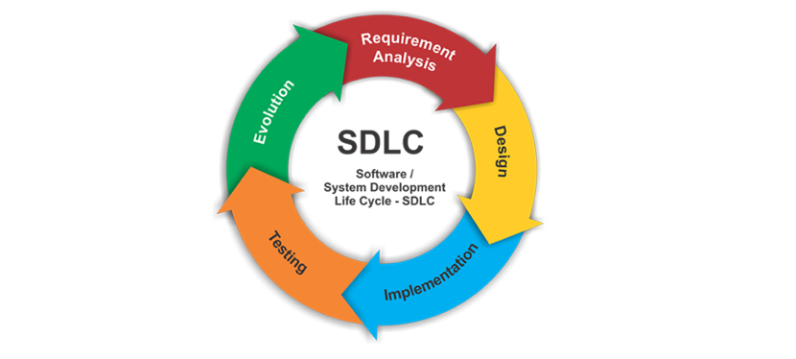
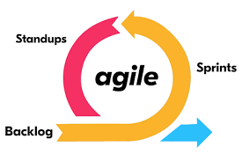


Learnings
Software development life cycle - requirements gathering, design, development, testing, deployment
Prioritizing requirement, pair programming, Git usage as collaborative tool, testing and validation
Agile methodology
Notes:
We learned about the end to end Software development life cycle which are - requirements gathering, design, development, testing, deployment.
We learned about prioritizing requirements, advantages of pair programming during development of daik·struh and A*, ease of using git for integrating our progress, different ways to test the system - alpha testing, beta testing and black box testing.
We used trello to keep track of tasks, and pending items. We worked in an agile way, where we had planning, stand ups to discuss the progress and any blocks one might have, and in the end retrospective meetings to what we have learned and what could be improved. Breaking down bigger tasks into smaller ones, keeping track of progress made it easier.

Slide 9
Questions
Notes:
This brings us to the end of our presentation. Thank you very much for attending our presentation. Our team is now open for questions.

